Slide 1
Crop Science
Lecture 5
07th September 2021
STAGES OF PLANT DEVELOPMENT

Slide 2
The shoot apex and phase changes
Higher plants pass through developmental stages,
in animals changes take place throughout the entire organism,
in higher plants they occur in a single, dynamic region, the shoot apical meristem
Shoot apical meristem passes through three more or less well-defined developmental stages in sequence:
1. The juvenile phase
2. The adult vegetative phase
3. The adult reproductive phase

Slide 3
Developmental stages of plants
The distinction between the juvenile and the adult vegetative phases is that the adult has the ability to form reproductive structures
flowers in angiosperms, cones in gymnosperms
Once the adult phase has been attained, it is relatively stable, and it is maintained during vegetative propagation
In some species, the juvenile meristem appears to be capable of flowering but does not receive sufficient floral stimulus until the plant becomes large enough.
Notes:
In mango (Mangifera indica), for example, juvenile seedlings can be induced to flower when grafted to a mature tree. In many other woody species, however, grafting to an adult flowering plant does not induce flowering.

Slide 4
Flower development
Floral meristems can be distinguished from vegetative meristems by their larger size
The transition from vegetative to reproductive development is marked by an increase in the frequency of cell divisions within the central zone of the shoot apical meristem
In the vegetative meristem, the cells of the central zone complete their division cycles slowly
As reproductive development commences, the increase in the size of the meristem is largely a result of the increased division rate of these central cells

Slide 5
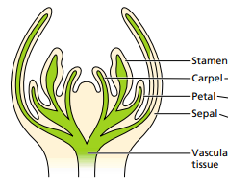
Flower development
As plants initiate reproductive development, vegetative meristem transform into floral meristems
Floral meristems initiate four different types of floral organs:
sepals
Petals
Stamens
Carpels

Slide 6
Plant classification
Plant flowering according to:
Temperature
Moisture

Slide 7
Plants Can Be Classified by Their Photoperiodic Responses
Plant species flower during the long days of summer as a consequence of the accumulation of photosynthetic products synthesized during long days
Short day plants flower only in short days or their flowering is accelerated by short days
Long day plants flower only in long days or their flowering is accelerated by long days

Slide 8
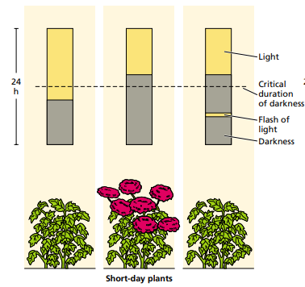
Day sensitive plants

Slide 9
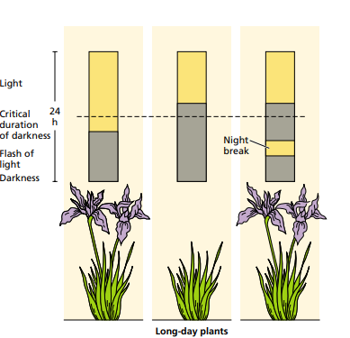

Slide 10
Photoperiodic Responses
Species that flower under any photoperiodic condition are referred to as day neutral plants
Day neutral plants are insensitive to day length
Flowering in day neutral plants is typically under autonomous regulation—that is, internal developmental control

Slide 11
Vernalization promoting flowering with cold
Vernalization is the process whereby flowering is promoted by a cold treatment given to a fully hydrated seed or to a growing plant
Without the cold treatment, plants that require vernalization show delayed flowering or remain vegetative

Slide 12
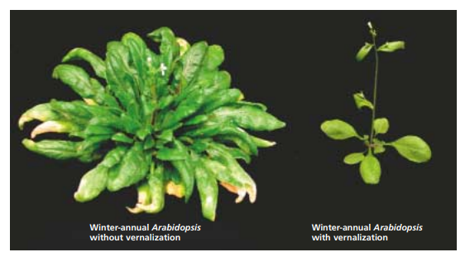

Slide 13
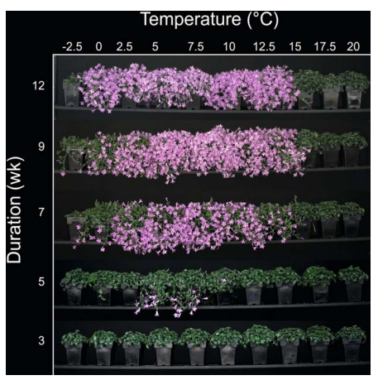

Slide 14
Flowering developmental pathway
The Transition to Flowering Involves Multiple Factors and Pathways
There are four genetically distinct developmental pathways that control flowering in plants
The photoperiodic pathway involves phytochromes and cryptochromes
In the dual autonomous/vernalization pathway, flowering occurs either in response to internal signals—the production of a fixed number of leaves—or to low temperatures.
The carbohydrate, or sucrose, pathway reflects the metabolic state of the plant, Sucrose stimulates flowering
The gibberellin pathway is required for early flowering and for flowering under noninductive short days

Slide 15
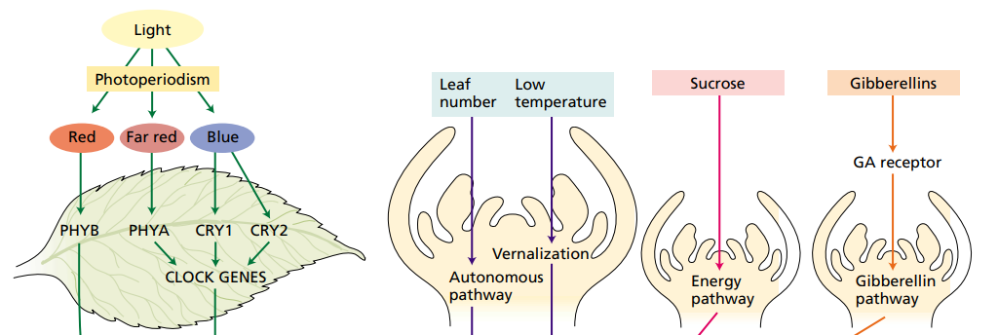

Slide 16
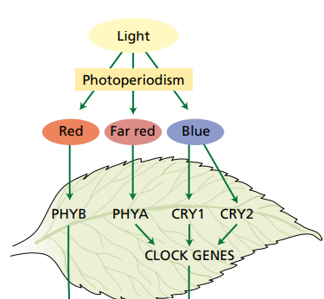

Slide 17
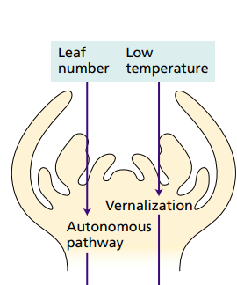

Slide 18
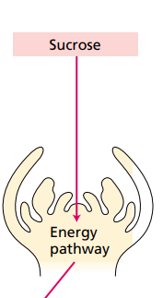

Slide 19
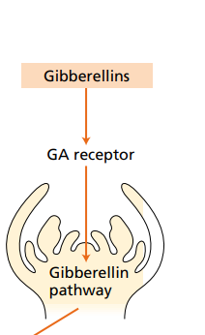

Slide 20
Senescence
Senescence in plants is a carefully programmed, hormonally controlled developmental process called programmed cell death
An early visible symptom of leaf senescence is leaf yellowing, due to loss of chlorophyll
Nitrogenous compounds are remobilized, as are most other compounds that can move in the phloem
After flowering, phloem-mobile nutrients are exported from the senescing leaves and roots to the developing fruits

Slide 21
Plant population
Maize
0.3m X 0.75m = 0.225m2
1 hectare - 100m X 100m = 10,000m2
10,000m2/0.225m2 = 44,444.44 plants
1 lima – 50m X 50m = 2,500m2
2,500m2/0.225m2 = 11,111.11 plants

Slide 22
Plant population
Cabbage
0.45m X 0.9m = 0.45m2
1 hectare – 10,000m2
10,000m2/ 0.45m2 = 22,222. 22 plants
1 lima – 2,500m2
2,500m2/ 0.45m2 = 5,555.55 plants

